Slide 1
Transaction Processing- I

Slide 2
Transaction Processing Systems
Transaction Processing Systems are the systems with large databases and hundreds of concurrent users executing database transactions.
For example airline reservations, banking, stock markets, etc.

Slide 3
Transaction
A transaction is an executing program that forms a logical unit of database processing.
A transaction includes one or more database access operations- these can include insertion, deletion, modification, or retrieval operations.
Transaction is executed as a single unit. It is a program unit whose execution may or may not change the contents of a database.

Slide 4
Example
A transfer of money from one bank account to another requires two changes to the database both must succeed or fail together.
Subtracting the money from the savings account balance.
Adding the money to the checking account balance.

Slide 5
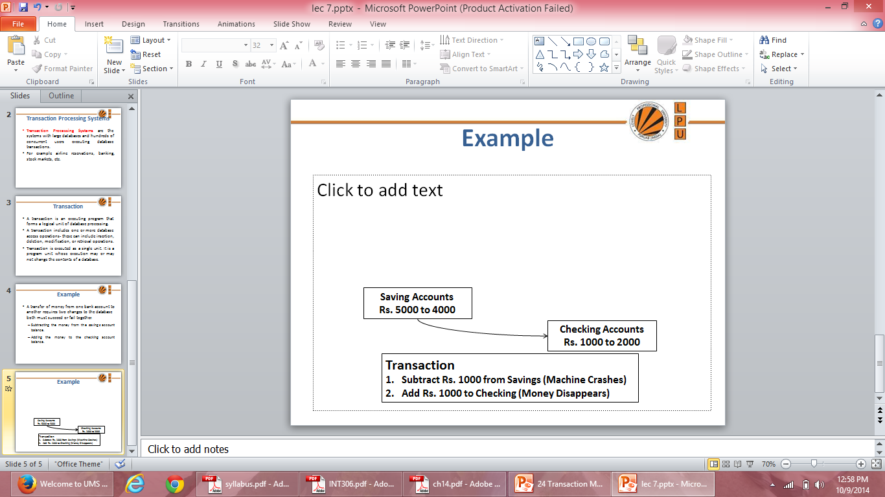
Example

Slide 6
Processes of Transaction
Read Operation
Write Operation

Slide 7
Desirable Properties of Transactions
ACID properties:
Atomicity: A transaction is an atomic unit of processing; it is either performed in its entirety or not performed at all.
Consistency: A correct execution of the transaction must take the database from one consistent state to another.
Isolation: A transaction should appear as though it is being executed in isolation from other transactions, even if many transactions are executing concurrently. That is, the execution of a transaction should not be interfered with any other executing transactions.
Durability: Once a transaction changes the database and the changes are committed, these changes must never be lost because of any failure.

Slide 8
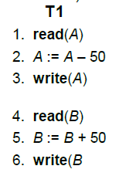
Transaction Properties
Let T1 be a transaction that transfers Rs 50 from account A to account B. This transaction can be defined as:
Say value of A prior to transaction was 1000 and that of B was 2000

Slide 9
Atomicity: Suppose that during the execution of T1, a power failure has occurred that prevented the T1 to complete successfully. The point of failure may be after the completion of Write(A) and before Write(B). It means that the changes in A are performed but not in B. Thus the values of account A and B are Rs.950 and Rs.2000 respectively. We have lost Rs.50 as a result of this failure.
Now, our database is in inconsistent state.
The reason for this inconsistent state is that our transaction is completed partially.
In order to maintain atomicity of transaction, the database system keeps track of the old values of any write and if the transaction does not complete its execution, the old values are restored to make it appear as the transaction never executed.

Slide 10
Consistency: The consistency requirement here is that the sum of A and B must be unchanged by the execution of the transaction. It can be verified easily that, if the database is consistent before an execution of the transaction, the database remains consistent after the execution of the transaction.
Ensuring consistency for an individual transaction is the responsibility of the application programmer who codes the transaction.

Slide 11
Isolation: If several transactions are executed concurrently (or in parallel), then each transaction must behave as if it was executed in isolation. It means that concurrent execution does not result an inconsistent state.
For example, consider another transaction T2, which has to display the sum of account A and B. Then, its result should be Rs.3000.

Slide 12
Durability: Once the execution of the transaction completes successfully, and the user who initiated the transaction has been notified that the transfer of funds has taken place, it must be the case that no system failure will result in a loss of data corresponding to this transfer of funds.

Slide 13
QUIZ
With regards to transaction processing, any DBMS should be capable of:
a. Ensuring that transactions are free from interference from other users.
b. Parts of a transaction are not lost due to a failure.
c. Transactions do not make the database inconsistent.
d. All of the above.
Notes:
d

Slide 14
QUIZ
What is ACID properties of Transactions?
a. Atomicity, Consistency, Isolation, Database
b. Atomicity, Consistency, Isolation, Durability
c. Atomicity, Consistency, Inconsistent, Durability
d. Automatically, Concurrency, Isolation, Durability
Notes:
b

Slide 15
QUIZ
Which of the following is not a property of a transaction?
a) Atomicity
b) Simplicity
c) Isolation
d) Durability
Notes:
b

Slide 16
QUIZ
Collections of operations that form a single logical unit of work are called __________
a) Views
b) Networks
c) Units
d) Transactions
Notes:
d

Slide 17
Transaction States
Active state– the initial state; the transaction stays in this state while it is executing .
Partially committed state– after the final statement has been executed.
Failed state -- after the discovery that normal execution can no longer proceed.
Aborted state– after the transaction has been rolled back and the database restored to its state prior to the start of the transaction. Two options after it has been aborted:
restart the transaction can be done only if no internal logical error
kill the transaction
Committed state – after successful completion

Slide 18
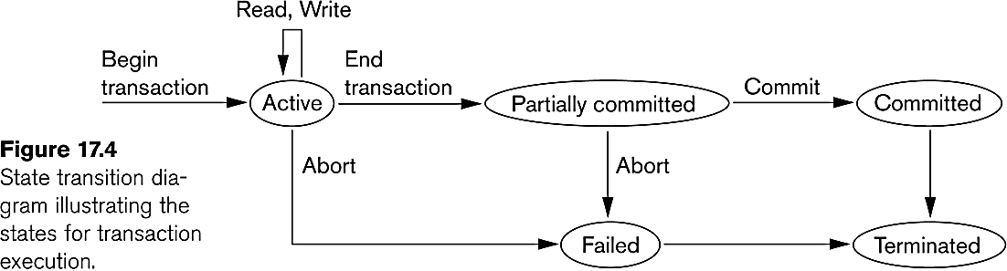
State Transition Diagram

Slide 19
QUIZ
The “all-or-none” property is commonly referred to as
a) Isolation
b) Durability
c) Atomicity
d) None of the mentioned
Notes:
c

Slide 20
QUIZ
Execution of transaction in isolation preserves the _________ of a database
a) Atomicity
b) Consistency
c) Durability
d) All of the mentioned
Notes:
b

Slide 21
QUIZ
Which of the following is not a transaction state?
a) Active b) Partially committed c) Failed d) Compensated
Notes:
d

Slide 22
QUIZ
Consider money is transferred from (1)account-A to account-B and (2) account-B to account-A. Which of the following form a transaction?
a) Only 1
b) Only 2
c) Both 1 and 2 individually
d) Either 1 or 2
Notes:
c

Slide 23
QUIZ
The database system must take special actions to ensure that transactions operate properly without interference from concurrently executing database statements. This property is referred to as
a) Atomicity b) Durability c) Isolation d) All of the mentioned
Notes:
c

Slide 24
QUIZ
A transaction is delimited by statements (or function calls) of the form __________
a) Begin transaction and end transaction
b) Start transaction and stop transaction
c) Get transaction and post transaction
d) Read transaction and write transaction
Notes:
a

Slide 25
QUIZ
The property of a transaction that persists all the crashes is
a) Atomicity
b) Durability
c) Isolation
d) All of the mentioned
Notes:
b

Slide 26
Concurrent Executions
Multiple transactions are allowed to run concurrently in the system.
Advantages are:
increased processor and disk utilization, leading to better transaction throughput
E.g. one transaction can be using the CPU while another is reading from or writing to the disk
reduced average response time for transactions: short transactions need not wait behind long ones.
Concurrency control schemes – mechanisms to achieve isolation that is, to control the interaction among the concurrent transactions in order to prevent them from destroying the consistency of the database

Slide 27
Why Concurrency Control is needed?
The Lost Update Problem
This occurs when two transactions that access the same database items have their operations interleaved in a way that makes the value of some database item incorrect.
The Temporary Update (or Dirty Read) Problem
This occurs when one transaction updates a database item and then the transaction fails for some reason
The updated item is accessed by another transaction before it is changed back to its original value.
The Incorrect Summary Problem
If one transaction is calculating an aggregate summary function on a number of records while other transactions are updating some of these records, the aggregate function may calculate some values before they are updated and others after they are updated.

Slide 28
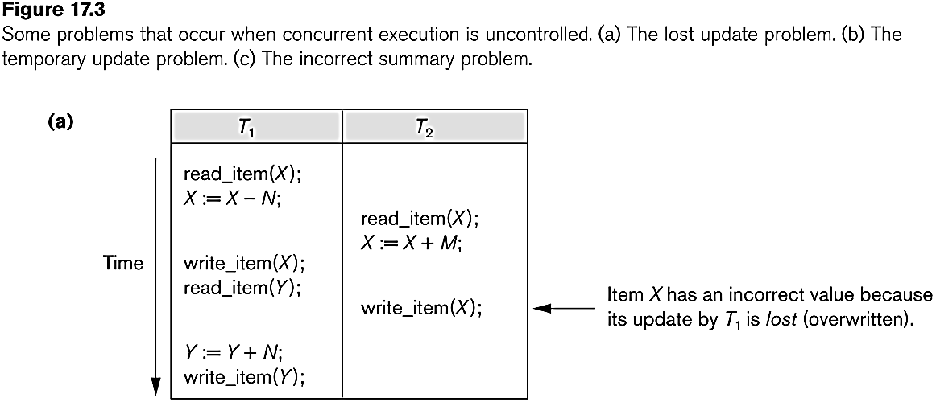
Concurrent execution is uncontrolled: (a) The lost update problem.

Slide 29
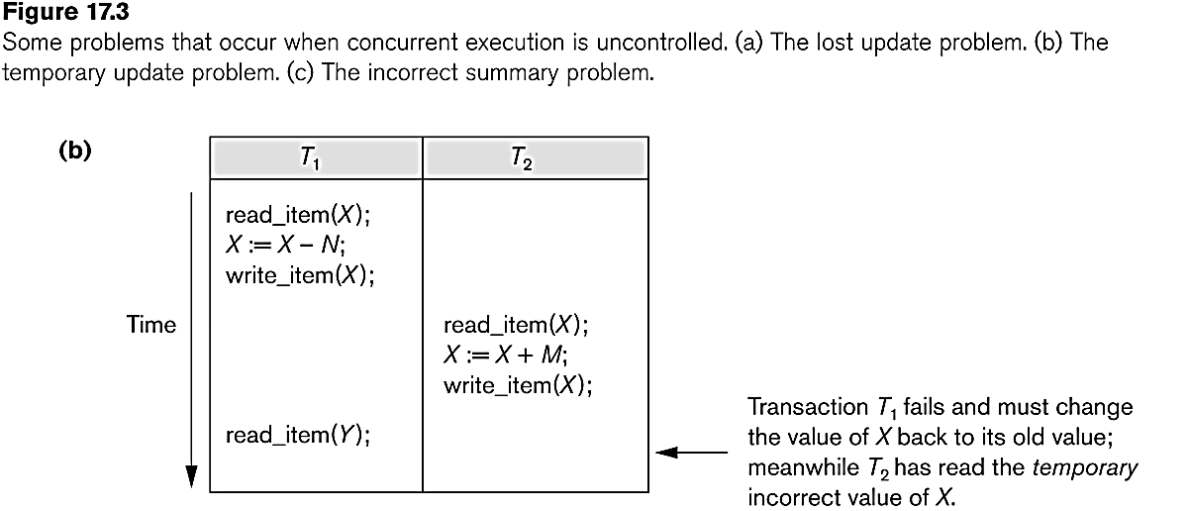
Concurrent execution is uncontrolled: (b) The temporary update problem.

Slide 30
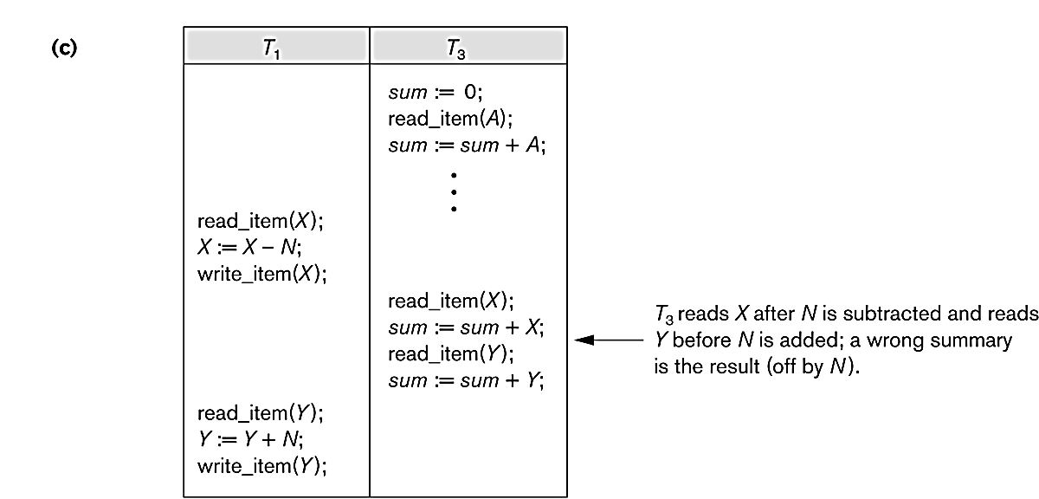
Concurrent execution is uncontrolled: (c) The incorrect summary problem.

Slide 31
Schedules
Schedule – a sequences of instructions that specify the chronological order in which instructions of concurrent transactions are executed
a schedule for a set of transactions must consist of all instructions of those transactions
must preserve the order in which the instructions appear in each individual transaction.
A transaction that successfully completes its execution will have a commit instructions as the last statement
by default transaction assumed to execute commit instruction as its last step
A transaction that fails to successfully complete its execution will have an abort instruction as the last statement

Slide 32
Scheduling of Transactions
Complete Schedule: A schedule that contains either an abort or a commit for each transaction whose actions are listed in it is called a complete schedule.
Serial Schedule: Each serial schedule consists of a sequence of instructions from various transactions, where the instructions belonging to one single transaction appear together in that schedule. If the actions of different transactions are not interleaved, we call that schedule a serial schedule.

Slide 33
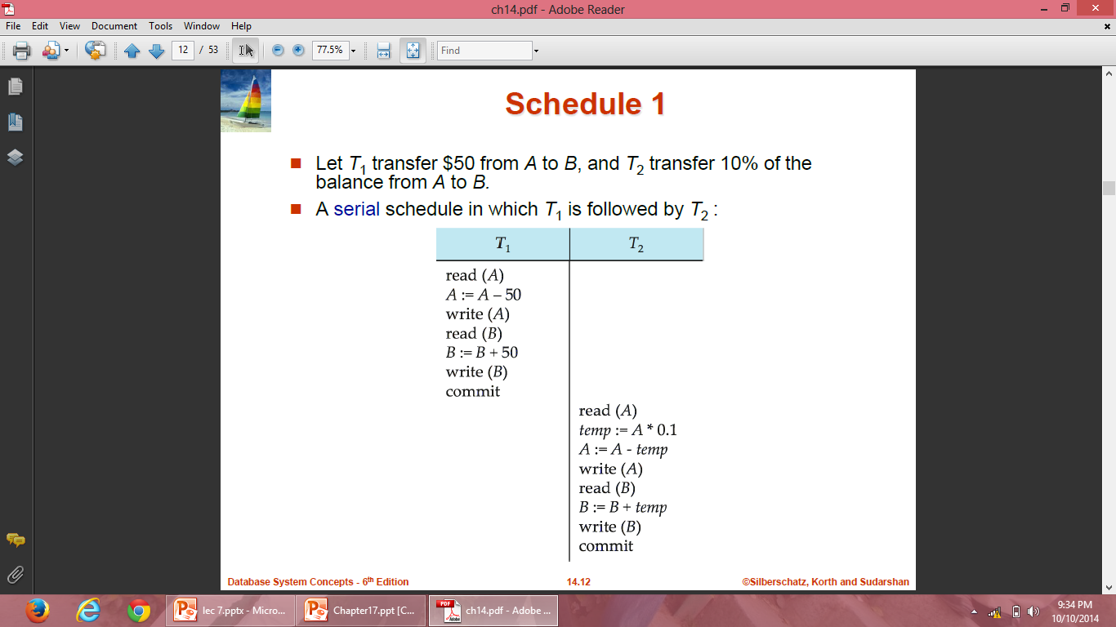
Schedule 1

Slide 34
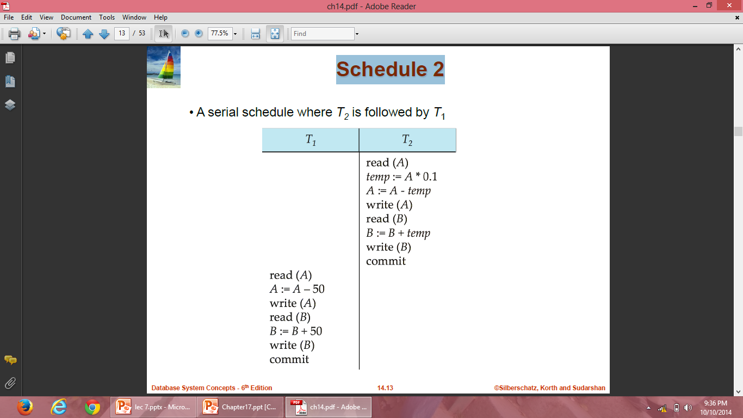
Schedule 2

Slide 35
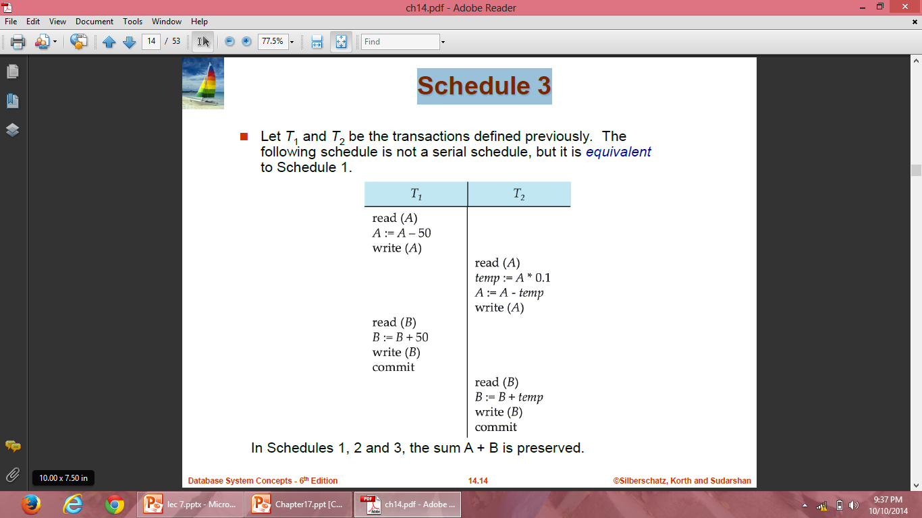
Schedule 3

Slide 36
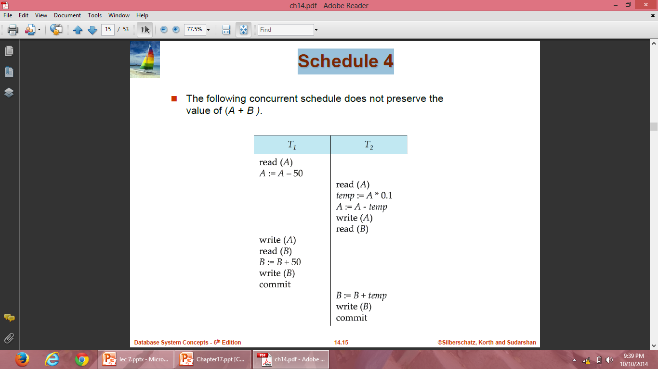
Schedule 4

Slide 37
QUIZ
The scheme that controls the interaction between executing transactions is called as _____
a) Concurrency control scheme
b) Multiprogramming scheme
c) Serialization scheme
d) Schedule scheme
Notes:
a

Slide 38
QUIZ
The execution sequences in concurrency control are termed as ________
a) Serials
b) Schedules
c) Organizations
d) Time tables
Notes:
b

